Slide 1
Physics 4 – Feb 6, 2020
Do now – Hand in IA paper drafts for feedback
More from Stan Misler
Objective:
5.3 Batteries
Assignment: p230 #30-36, p226 # 24, 29
Agenda:
EMF
Ideal Batteries
Real Batteries
Potential Dividers

Slide 2
Electromotive Force
An EMF doesn’t have to be a battery, it’s just that batteries are by far the most common.
What is needed is a source of a potential difference, an electromotive force (EMF), symbolized by .
An EMF converts some other form of energy into electrical energy.
EMF source | Type of energy converted
Battery | Chemical
Generator | Mechanical
Thermocouple | Thermal energy
Solar cell / photovoltaic cell | Light energy

Slide 3
Ideal Batteries
The chemical reaction occurring within a battery is an oxidation reduction reaction that serves to move ions from one location to another.
The positive terminal (the cathode) is where a reduction occurs. (Electrons move onto chemicals.) The cathode becomes positive and a higher potential.
The negative terminal (the anode) is where an oxidation occurs. (Electrons are removed from chemicals.) The anode becomes negative. Lower V.
The specific chemicals used in the redox reaction identifies the names used for batteries: Cd, Zn, Li etc…
I
-
+
current

Slide 4
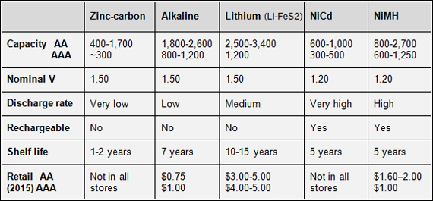
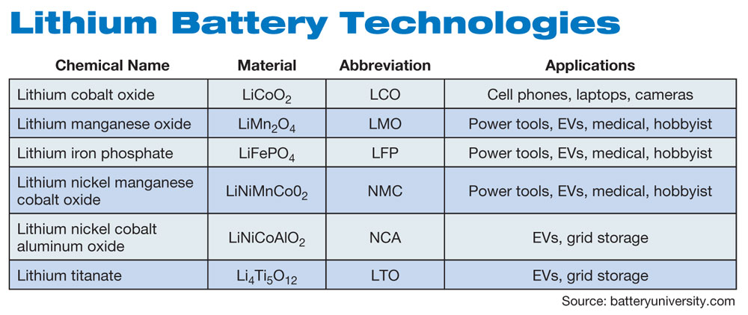
Types of Batteries

Slide 5
Real batteries
Real batteries have an internal resistance.
The terminal potential difference, V, is not exactly equal to the electromotive force, , but is something less because some energy gets dissipated by the internal resistance, r.
V =  - Ir
V =  only if the current = 0
Treat the internal resistance as another resistor connected in series next to the battery.

Slide 6
Sample Problems
Find the EMF of the battery and the internal resistance for the graph.

Slide 7
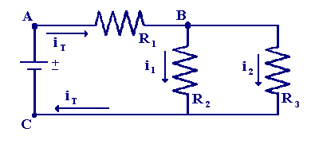
Sample Problems
A R₁ = 4 , R₂ = 3 , and R₃ = 6  are connected to a 18V power source as shown. Solve the resulting circuit if the battery has an internal resistance of 0.10 .

Slide 8
Sample Problems
When two resistors, each of resistance 8  are connected in parallel with a battery, the current leaving the battery is 2.5 A. When the same two resistors are connected in series with the battery, the total current in the circuit is 0.65 A. What is the EMF of the battery and the internal resistance?

Slide 9
Capacity
Capacity is the amount off charge a battery can deliver in its lifetime. Higher current, shorter life.
The terminal potential varies some as a cell discharges.

Slide 10
Charging a battery
You can charge a secondary battery by placing it “backwards” in the circuit.
Remember the sign conventions for Kirchhoff’s loop rule?
A battery that is backwards drains potential.
That energy loss is transferred into chemical energy recharging the battery.

Slide 11
Galvanometers
A galvanometer is an instrument that uses moving magnetic fields to measure currents. (we’ll look into the interaction between magnetic fields and currents in the next lesson.)
For now, know that IB considers galvanometers to be a general kind of analog electrical sensor. They give it symbol of an arrow in a circle, like a little dial.
If its connected in series, its acting like an ammeter.
If its connected in parallel, its acting like a voltmeter.
Should only be a current sensor, but IB seems to generalize.

Slide 12
Potential Dividers
Consider the potentials listed for any series circuit you have solved.
The total potential for the circuit is divided amongst all of the series resistors.
If you want to use a 24 V power source, but only want to expose some resistor or load of interest to a lower voltage, you could use a “potential divider”, or an extra resister in series with the battery.
A real potential divider allows one to dial up any desired potential by creating a circuit with a variable amount of series resistance.

Slide 13
A potential divider
The potential you use for Resistor R is the battery voltage LESS the potential used in Resistor R₂ , or the part of the variable resistor to the right of S.

Slide 14
Potential divider problem
The XY bar for this potential divider is made from a material that has a uniform linear resistance of 3.5 /cm. You connect this potential divider to a 20  resistor and a cell with a 16 V potential. If the current in the resistor needs to be 0.400 A and the XY bar is 6.00 cm long, how far from X does the connection point S need to be set?

Slide 15
Exit slip and homework
Exit Slip – The potential difference across the terminals of a battery is 4.8 V when the current is 1.2 A and 4.4 V when the current is 1.4 A. Determine the emf of the battery and the internal resistance.
What’s due? (homework for a homework check next class)
Ch 5.3 p230 #30-36
What’s next? (What to read to prepare for the next class)
Read Ch 5.4 p 232 – 241 Magnetism

